Slide 1
Up-gradation of GMC Srinagar Originally Conceived as Institute of Traumatology and allied Superspecialties for GMC Srinagar
Under PMSSY Scheme
No:- Z 29013/1/2004 SSH dated 21.9.2006.
BUILDING TAKEN OVER FROM CPWD ON 01.07.2015
IPD FACILITY STARTED IN JUNE 2016

Slide 2
Background
Area 5.3 acres, situation Karan Nagar.
Four storey building. Ground floor and three floors. Total square area 12730 sq.mt
Bed strength 220 beds.
Operation theatres: -
Ground Floor (02 Tables) for Day procedures .
Third floor ( 06 Tables)
modular and integrated ( 03 Tables)

Slide 3
Originally conceived as Institute of Trauma & allied Specialties.
Presently catering to Super Specialty facilities (Seven/Medical/Seven Surgical/Anesthesiology/Radiology)

Slide 4
VISION Concern, Consideration, Compassion and Commitment
Delivering tertiary, quaternary non intrusive health care with human touch
Ensuring
care with integrity and ethics.
Adhering to National and International norms.
Integrating and synchronising allied super-specialities.
Clubbing research, education and patent care at the supra optimum levels.
Achieving professional excellence.
MOTTO “PATIENT FIRST”

Slide 5
SERVICES
Support Services
S.NO | SERVICE | SPECIFICATION | DEFICIENCY IF ANY
1 | WATER SUPPLY | ONE TUBE WELL MAIN SUPPLY 2 INCHES SUMP 30000 LTS MAIN TANKI 02 OF 25000 EACH FIRE FIGHTING 25000LTS
2 | STP | 01 MLD
3 | ELECTRICAL | Shireen Bagh 11000 v. UPS facility to the tune of 100 % for OT’s and ICU’s AVR INSTALLED
4 | DG SETS | 750kv x 3 | One non functional
5 | LIFTS | 3 NO’S OF 26 PASSENGERS | two functional and one expected to be functional soon
 |  | 2 NO’S OF 08 PASSENGERS | Both non functional
6 | OXYGEN PLANT | Three Plants of 800 LPM 500 LPM,1000LPM functional with additional backup of vital areas.
10 | CCTV | INSTALLED
11 | EPABX | INSTALLED
12 | LAN | INSTALLED
13 | CSSD | 02 horizontal autoclaves available + ETO facility available+H₂O₂ Plasma
14 | FIRE FIGHTING | Hydrant/ extinguishers

Slide 6
Specialities Available
S No | Name of the Speciality | OPD FACILITY |  | IPD FACILITY
1 | GASTROENTEROLOGY | BOTH
2 | NEUROSURGERY | BOTH
3 | UROLOGY | BOTH
4 | CVTS | BOTH
5 | SURGICAL ONCOLOGY | BOTH
6 | CARDIOLOGY | BOTH
7 | PLASTIC AND RECONSTRUCTIVE SURGERY | BOTH
8 | SURGICAL GASTROENTEROLOGY | BOTH
9 | NEPHROLOGY | YES |  |  | Dialysis ( emergency) only
10 | CLINICAL HAEMATOLOGY | BOTH
11 | NEUROLOGY | BOTH
12 | ENDOCRINOLOGY |  | BOTH
13 | MEDICAL ONCOLOGY |  | BOTH
14 | PAEDIATRIC SURGERY | BOTH
15 | Deptt. Of Radiology | BOTH
16 | Anaesthesiology & Critical Care | BOTH

Slide 7
IPD STATISTICS
YEAR | NO. OF ADMISSIONS
2016 | 2386
2017 | 5558
2018 | 8121
2019 | 13900
2020 | 15119
2021 | 20910

Slide 8
OPD STATISTICS
YEAR | NO. OF PATIENTS
2016 | 32430
2017 | 97498
2018 | 103625
2019 | 129444
2020 | 83752
2021 | 91196

Slide 9
COVID WORK
HEALTH WORKERS WHO TESTED POSITIVE | 229
NUMBER OF RAT TESTS DONE | 16153
NUMBER OF RTPCR DONE | 28737
ADMIITED PATIENTS WHO WERE COVID-19 POSITIVE | 230
COVID POSITIVE DEATHS | 06

Slide 10
WORK DONE
 | 2016 | 2017 | 2018 | 2019 | 2020 | 2021
OPD consultations | 32430 | 97498 | 103625 | 129444 | 88752 | 91196
IPD admissions | 2386 | 5558 | 8121 | 13900 | 15119 | 20910
Major surgeries performed | ------- | 215 | 912 | 1640 | 1429 | 2852
Minor surgeries performed | ------- | 551 | 2595 | 3892 | 2737 | 5624
Chemotherapies administered | ------- | -------- | ------- | 142 | 3939 | 4853
Cardiac procedures performed | ------- | -------- | ------- | 2205 | 3034 | 4185
Hemodialysis performed | 124 | 1641 | 2464 | 2442 | 1924 | 2091
Gastroenterology procedures | 8791 | 9263 | 10442 | 11165 | 5967 | 6574
Radiological Investigations | 7668 | 14404 | 22783 | 31656 | 16460 | 15410

Slide 12
UPGRADATION
Facility | YEAR
BONE DEXA SCAN | 2015
AUGMENTATION OF DIALYSIS MACHINES | 2017
OPERATION THEATRES | 2018
CANTEEN SERVICES | 2018
ECHO | 2019
SICU | 2019
CATH LAB | 2019
AMRIT | 2019
SPECIALISED OT EQUIPMENT | 2020
CRYOSTAT INSTALLATION | 2021
NEUROPHYSIOLOGICAL LAB | 2021
FIBROSCAN | 2021
SLEEP LAB | 2022
H2O2 PLASMA | 2022
KTU | 2022
JAN AYUSHDI | 2022

Slide 13
WORK DONE UNDER AB PMJAY SEHAT SCHEME
REGISTRATION DONE SINCE 26 DEC 2020 TO TILL DATE | 18736
CLAIMS SETTLED | 16855
CLAIMS UNDER PROCESS | 1881
IMPLEMENTATION OF CLAIM UTILIZATION GUIDELINES ISSUED BY H&ME | YES
CONVERSION RATE=89%

Slide 14
ISSUES RELATED TO OUR HOSPITAL PRESENTLY
S.NO. | NAME OF THE FACILITY | ISSUE | ACTION TAKEN
01. | OPD | Inadequate Space | Upcoming OPD Block, Stores, Faculty rooms in Premises of SSH Work in progress
02. | STORES | No Space demarcated
03. | FACULTY ROOMS | In adequate number
04 | SUPER SPECIALTY ADMISSIONS | In adequate number of beds for each specialty | Matter taken up with higher authorities.
05. | LABS | No Pathology/Bio-Chemistry/Microbiology | Space being identified for the same. Faciltiies shared with SMHS Hospital for the time being.
06 | BLOOD BANK | No Separate Blood Bank in SSH
07. | PUBLIC CONVENIENCE FACILITY | Not available around the OPD/Registration Counter area. | Matter taken up with the concerned Engineering wing.
08. | CATEGORIES OF POSTS* | Non Created | Creation of plumbers, electrician’s drivers, cleaners, sweeper’s posts projected.
09. | CAUSALTY | Non Functioning because of dearth of staff, conversion into store and sewage leakage from the ceilings because of choked pipes. | Dearth of staff (Medical/ Para Medical) projected. The issue of seepage discussed with Chief Engineer CPWD but no concrete action taken by them till date.
10. | MRD SECTION | Non Computerized | Process has been undertaken and expected to be completed soon.
11. | B STORE | No Such Facility | Matter taken up with the concerned Engineering wing.
12 | Staff of SSH(borne on our establishment) & posted in other associated Hospitals

Slide 15
CREATION OF POSTS
S.No. | Name of the posts | Requirement
1 | Drivers | 4
2 | Cleaner | 2
3 | Sweeper | 30
4 | Cook | 2
5 | X-Ray Tech | 10
6 | Medical Record Keeper | 2
7 | Data Entry Operator | 6
8 | Plumber | 3
9 | Telephone Operator | 6
10 | STP Supervisor | 1
11 | Jr. Stenographer | 4
12 | Sr. Stenographer | 2
13 | Electric Foremen | 1
14 | Sr. Electrician | 2
15 | Jr.Electrician | 6
16 | Fitter | 2
17 | Carpenter | 2
18 | Barber | 2
19 | CSSD Assistant | 2
20 | CSSD Attendant | 2
21 | Gardeners | 2
22 | Mech. Foreman | 2
23 | Sanitary Inspectors | 1
24 | Jamadars | 1
25 | Medical record Tech. | 1
26 | Sr. Receptionist | 2
27 | Jr. Assistant | 10
28 | Stenotypist | 6
29 | Lift Operator | 8
30 | Sr. Plumber | 1
32 | Dialysis Assistant | 4
33 | House Keeping Manager | 1

Slide 16
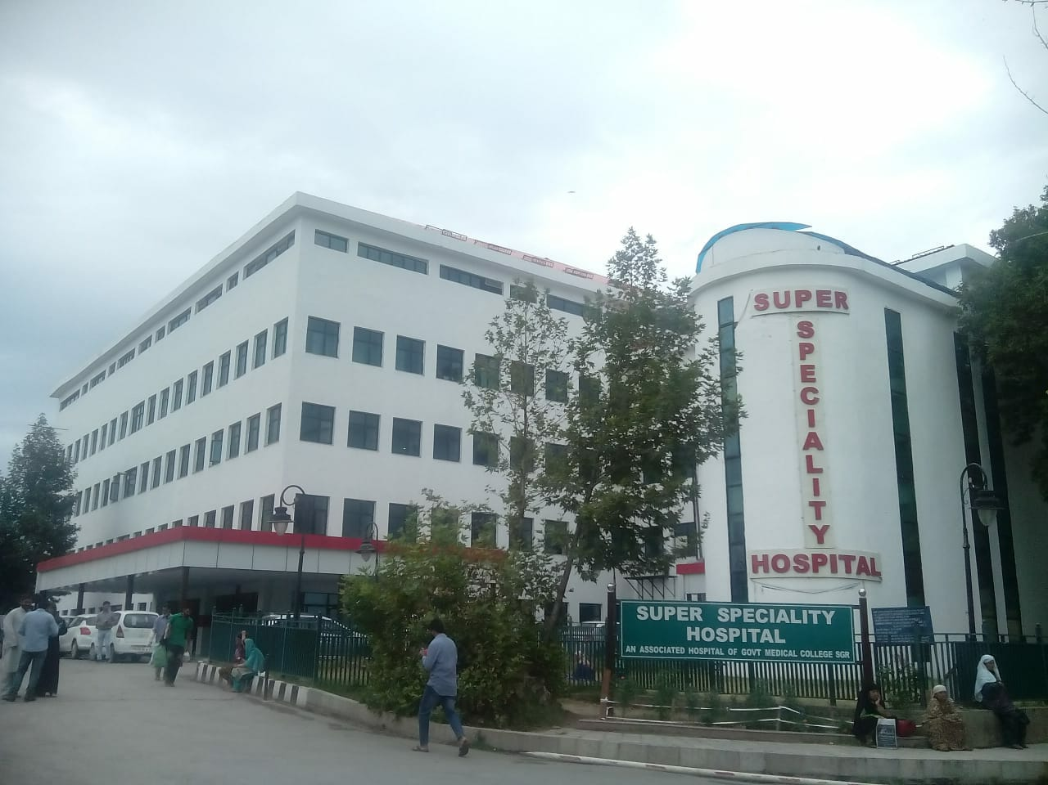
SS H

Slide 17
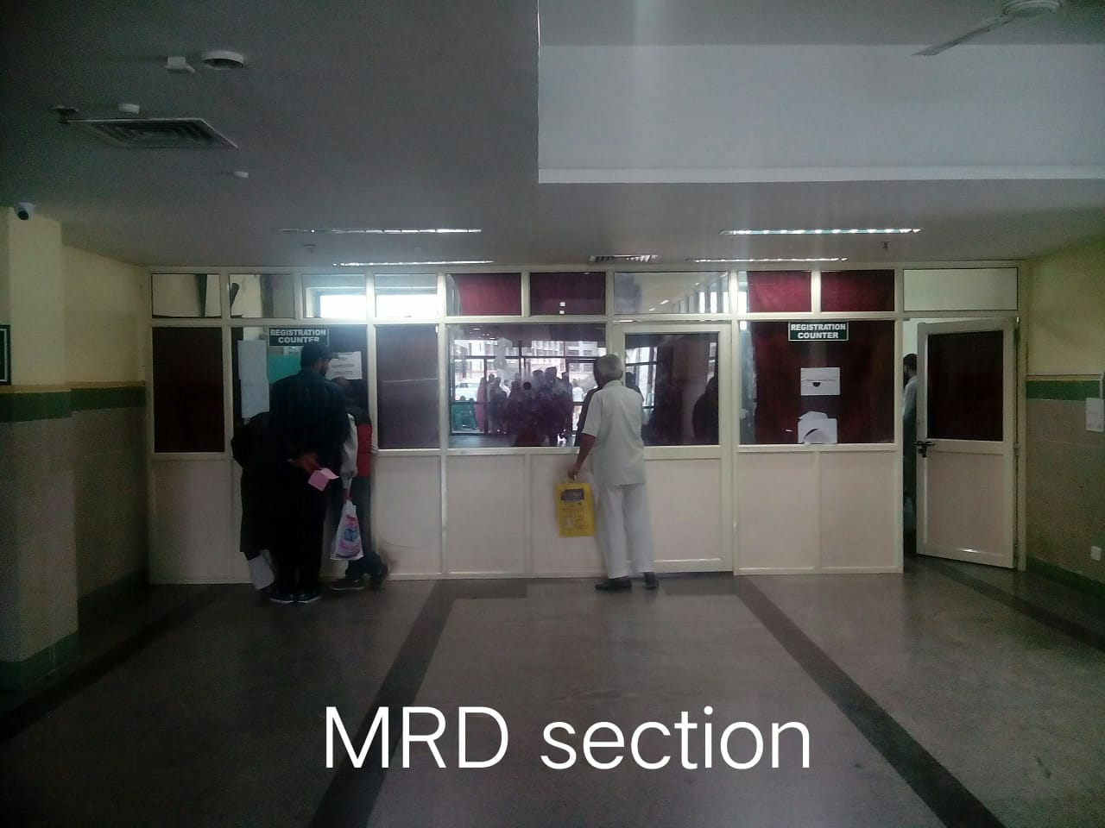
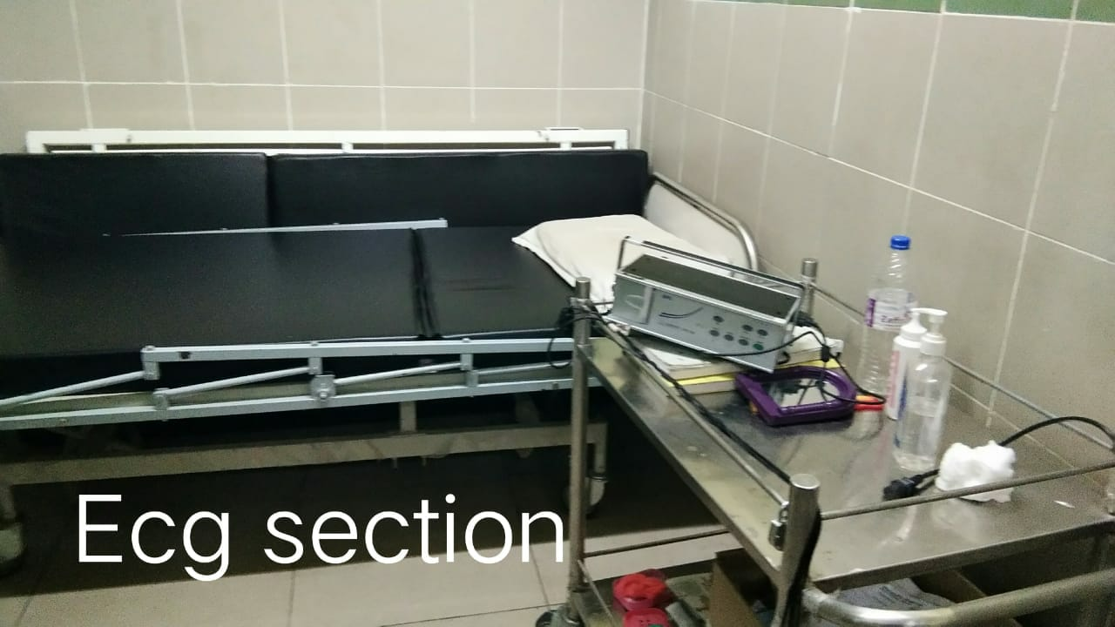
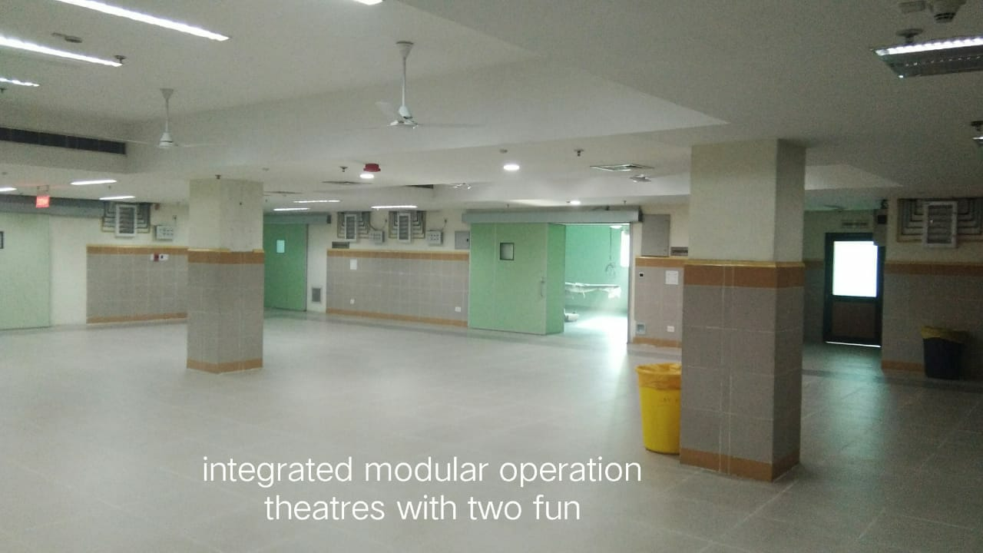
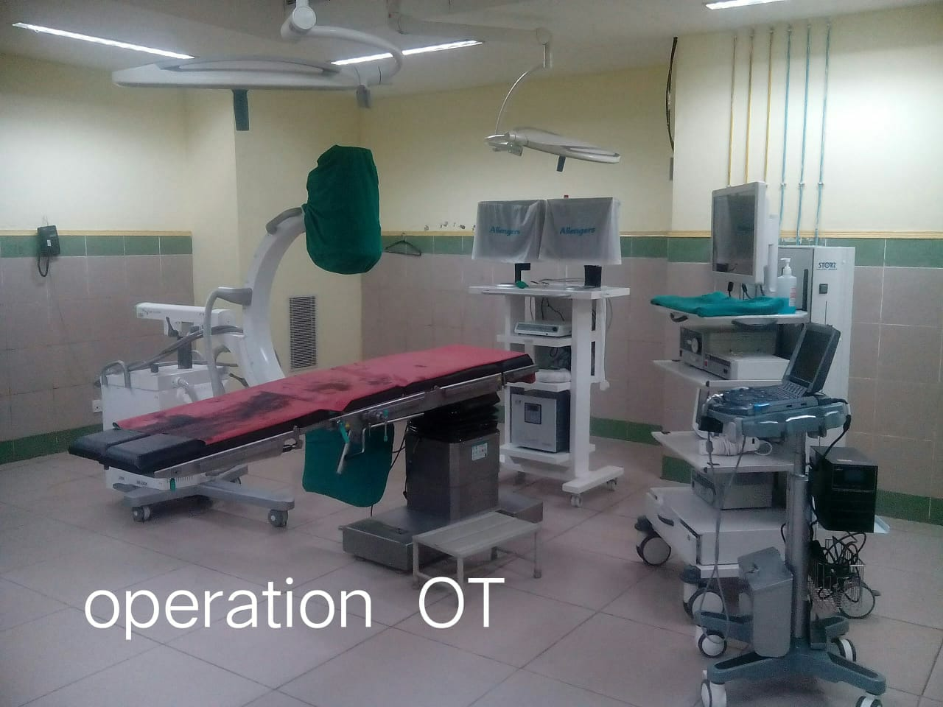

Slide 18
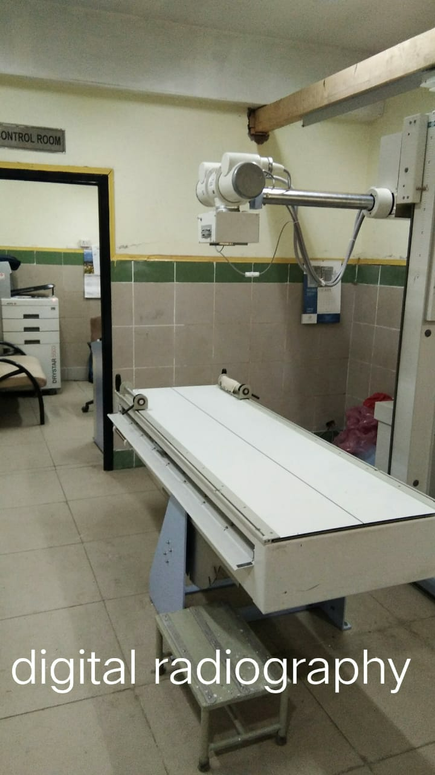
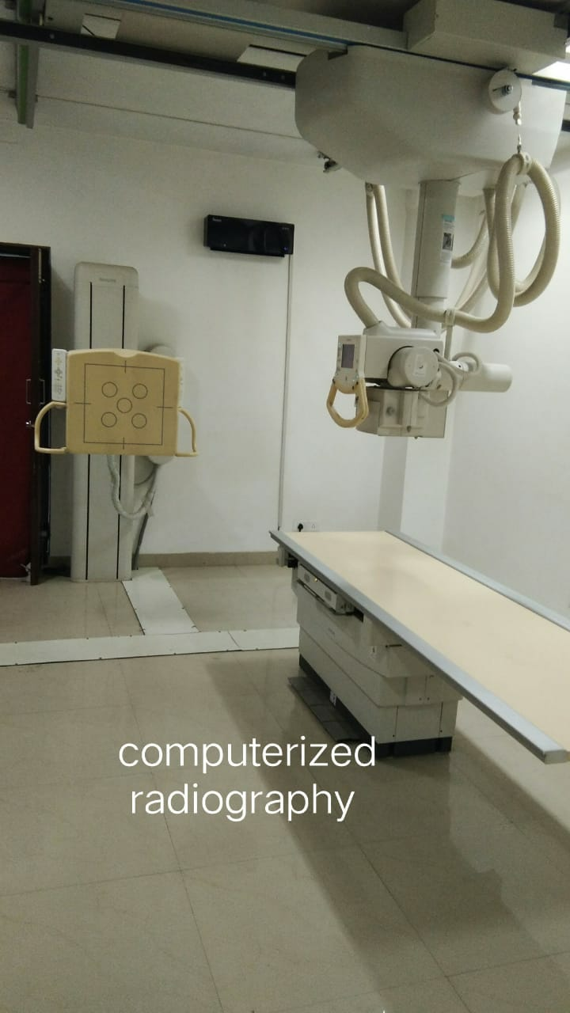

Slide 19
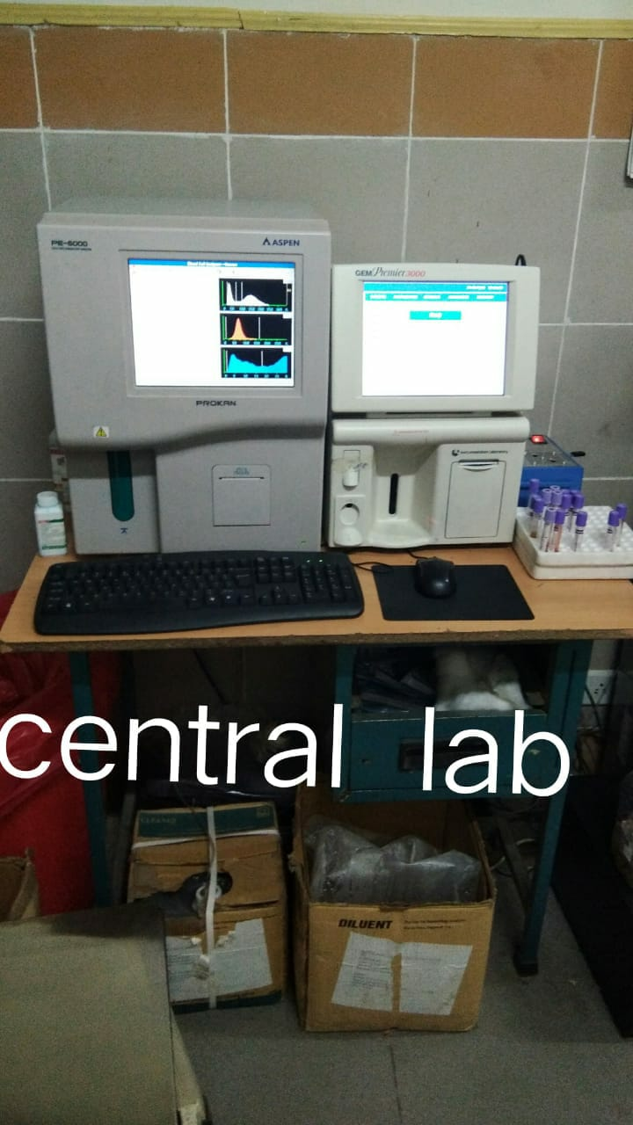
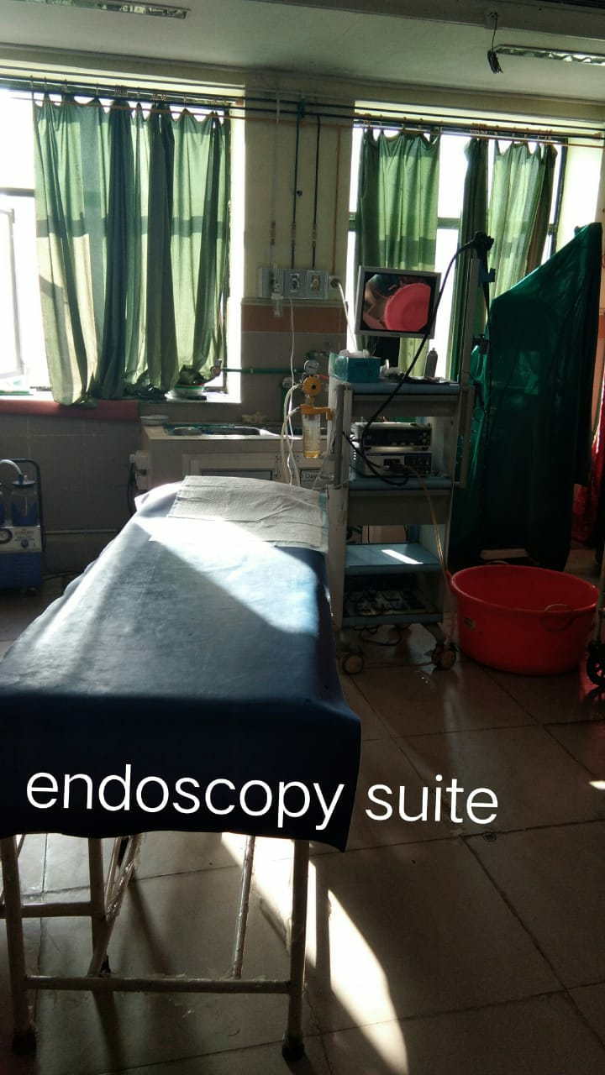

Slide 20
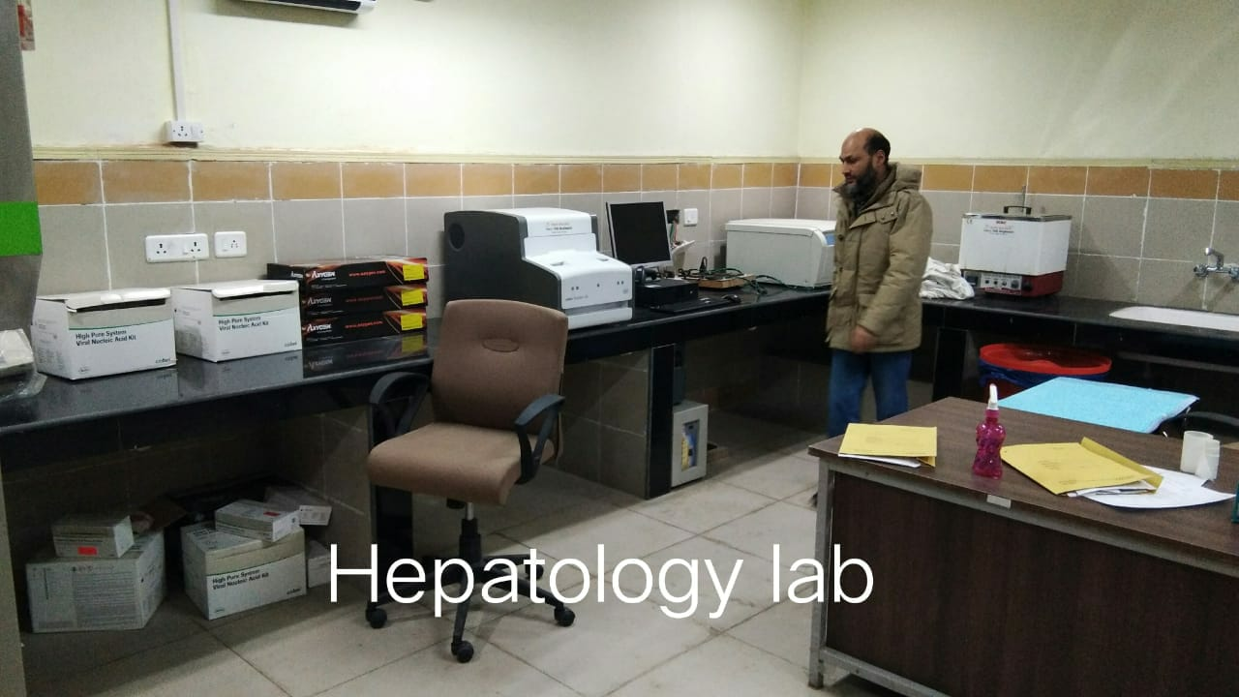
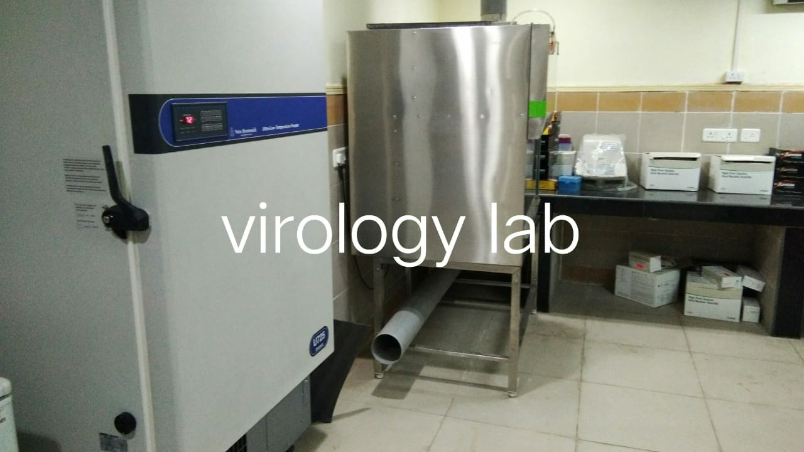
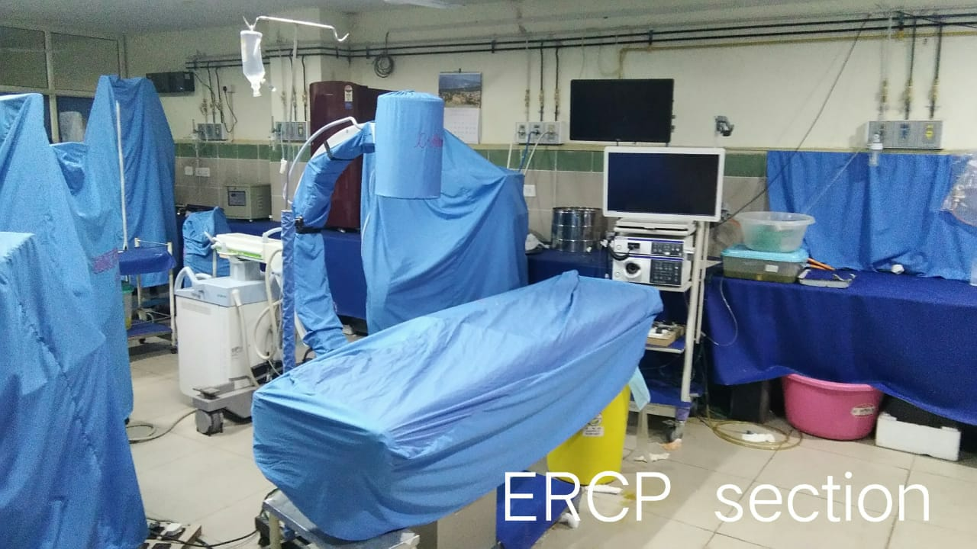
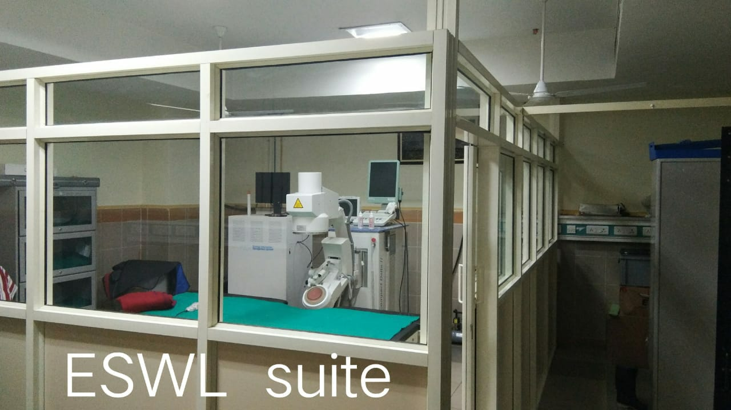

Slide 21
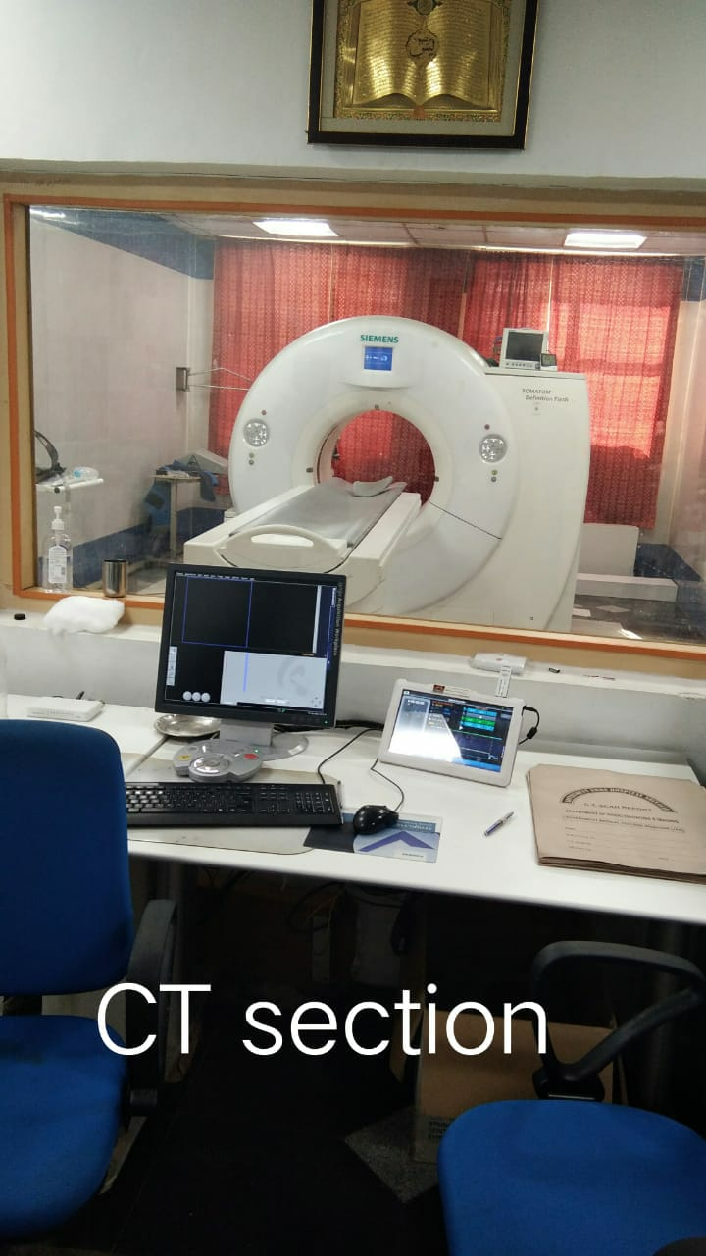
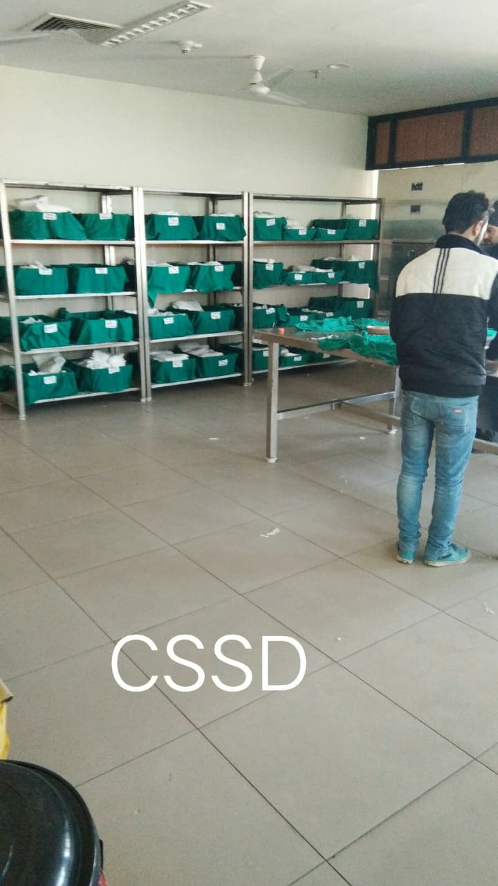

Slide 22
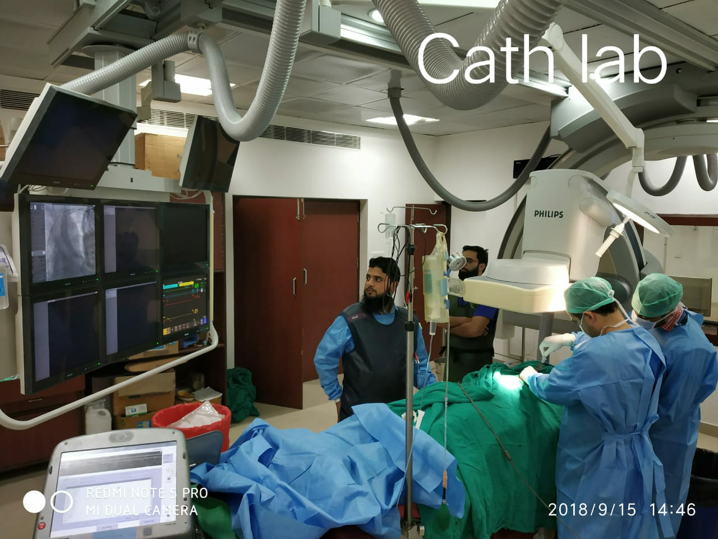
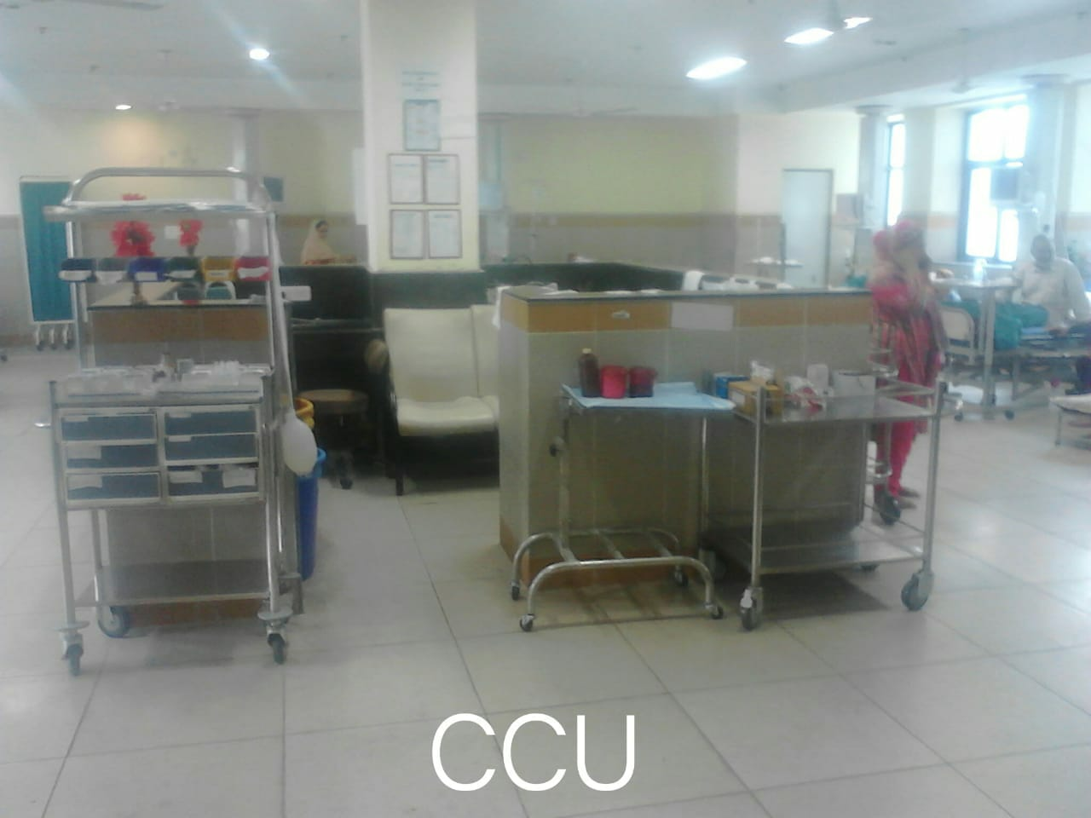
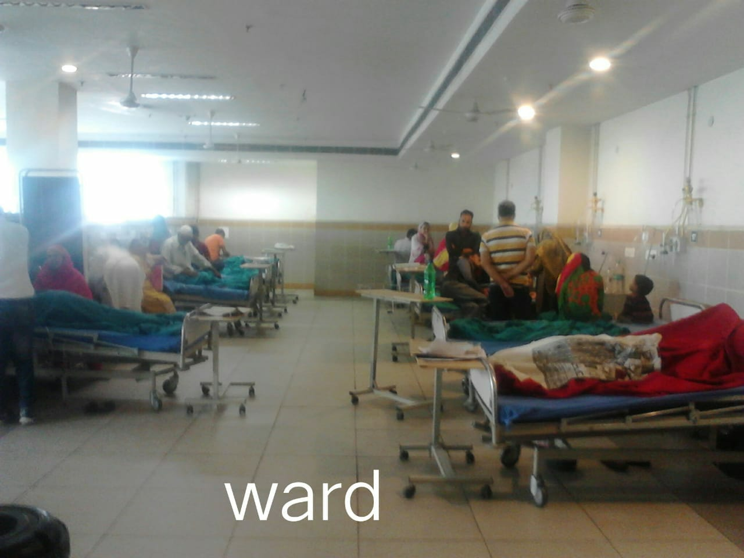

Slide 23
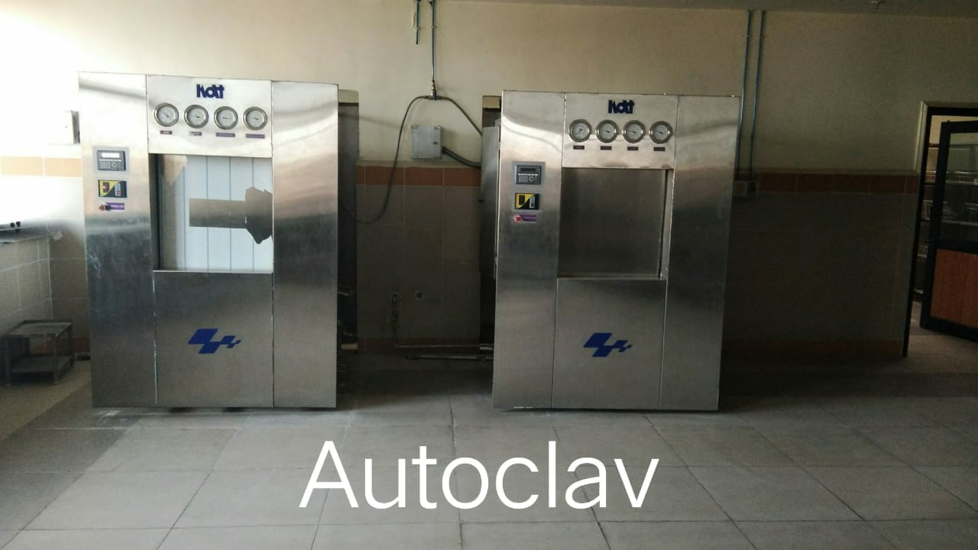
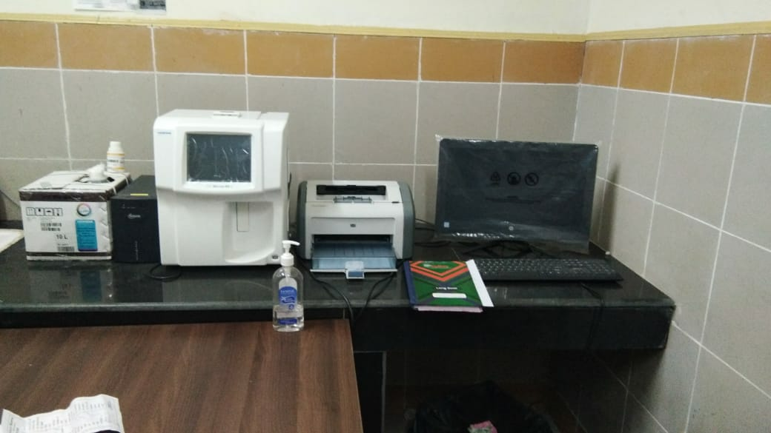
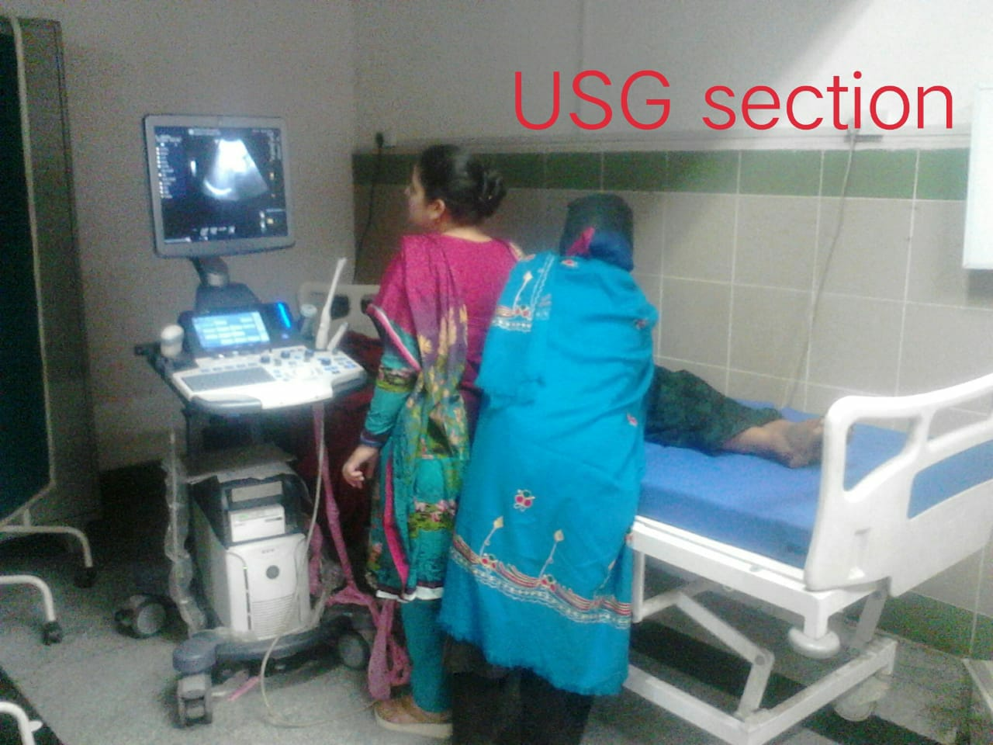

Slide 24
UPCOMING
1.NEW OPD BLOCK HOUSING
OPD
BLOOD BANK
LABS
STORES
2.CREATION OF NEPHROUROLOGICAL UNIT

Slide 25
WARD | WARD NO. | FLOOR
DAYCARE WARD | 01 | GROUND FLOOR
ENDOCRINOLOGY WARD | 02 | GROUND FLOOR
CARDIOLOGY WARD | 03 | IST FLOOR
CVTS WARD | 04 | IST FLOOR
NEUROSURGERY WARD | 05 | IST FLOOR
PAEDIATRIC AND SURGICAL GASTRO WARD | 06 | IST FLOOR
NEUROLOGY WARD | 07 | IST FLOOR
UROLOGY AND NEPHROLOGY WARD | 08 | 2ND FLOOR
DIALYSIS WARD | 02(B) | 2ND FLOOR
MEDICAL GASTRO WARD | 09 | 2ND FLOOR
PLASTIC SURGERY AND SURGICAL ONCOLOGY WARD | 10 | 2ND FLOOR
SICU WARD | 11 | 3RD FLOOR

Slide 26
THANK YOU
Dr. MAK (22-11-2018)

